Slide 1
CHAPTER 4:
Enhanced Entity Relationship (EER) Modeling
DCI2033 – DATABASE SYSTEMS

Slide 2
Learning Outcomes
Student should be able to:
  Define the basic of terms of extended entity relationship EER
  Use of Supertype/Subtype relationships
  Use of generalization and specialization techniques
  Apply disjoin and nondisjoin constraints
  Construct EER model based on realistic business situations
  How entity clusters are used to represent multiple entities and relationships
  What issues to check for when developing data models based on EER diagrams

Slide 3
The Enhanced Entity Relationship Model
Result of adding more semantic constructs to original entity relationship (ER) model
Diagram using this model is called an EER diagram (EERD)

Slide 4
Entity Supertype and Subtype
Table 4.1: Null created by unique attributes in table Employee
staffNo | name | birthDate | typeSpeed | field | deanStartDate
S0010 | Mohd Kamal | 9/9/1960 |  |  | 1/1/2009
S0500 | Haaris | 21/2/1975 |  | Comp Sc
S0101 | Fauziah | 7/5/1979 | 150
S1100 | Rozlina | 8/1/1970 |  | SE
S0120 | Ismalina | 9/9/1983 | 100
Attributes appropriate for typists
Attributes appropriate for lecturers
Attributes appropriate for deans
Attributes appropriate for all staffs

Slide 5
Entity Supertype and Subtype (2)
Entity Supertype
  Generic entity type related to one or more entity Subtype
  Contains common characteristics
Entity Subtype
  Contains unique characteristics of each entity Subtype

Slide 6
Entity Supertype and Subtype (3)
Indicates specialization/generalization
Supertype
Staff
Work
Department
staffNo (PK)
name
birthDate
1..*
Participation Constraints
1..1
Shared attributes
Disjoint Constraints
1..1
Unique attributes
(Optional, And)
Lead_By
Typist
Lecturer
Dean
typeSpeed
field
startDate
1..1
Subtype

Slide 7
Supertype/Subtype Relationships
Shows arrangement of higher-level entity Supertype and lower-level entity Subtype
Relationships described in terms of “IS-A” relationships
Subtype exists only within context of Supertype
Every Subtype has only one Supertype to which it is directly related
Can have many levels of Supertype/Subtype relationships

Slide 8
Attribute Inheritance
Enables entity Subtype to inherit attributes and relationships of Supertype
All entity Subtype inherit their primary key attribute from their Supertype
At implementation level, Supertype and its Subtype(s) maintain a 1:1 relationship
Entity Subtype inherit all relationships in which Supertype entity participates
Lower-level Subtype inherit all attributes and relationships from all upper level-Supertype

Slide 9
Entity Supertype and Subtype (4)
Table 4.1: Null created by unique attributes in table Employee
staffNo | name | birthDate | typeSpeed | field | deanStartDate
S0010 | Mohd Kamal | 9/9/1960 |  |  | 1/1/2009
S0500 | Haaris | 21/2/1975 |  | Comp Sc
S0101 | Fauziah | 7/5/1979 | 150
S1100 | Rozlina | 8/1/1970 |  | SE
S0120 | Ismalina | 9/9/1983 | 100
Table 4.1 can be replace with more manageable table through
Supertype and Subtype entity

Slide 10
Entity Supertype and Subtype (5)
Table Name: Staff
Table Name: Lecturer
staffNo | name | birthDate
S0010 | Mohd Kamal | 9/9/1960
S0500 | Haaris | 21/2/1975
S0101 | Fauziah | 7/5/1979
S1100 | Rozlina | 8/1/1970
S0120 | Ismalina | 9/9/1983
staffNo | Lec_field
S0500 | Comp Sc
S1100 | SE
Figure 4.1: The Staff-Lecturer Supertype-Subtype relationship

Slide 11
Advantages of Supertype &
Subtype
The concepts of introducing supertype and subtype into ER model provides following enhance feature :
  Avoids the needs to describe similar concepts more than
once,save time for data modelling process
  More readable and better looking ER diagrams
  Supertype and subtype relationship add more semantic content and information to the design in more concise form

Slide 12
Specialization
Specialization
  Identifies more specific entity subtypes from higher-level entity supertype
  Top-down process
  Based on grouping unique characteristics and relationships of the subtypes

Slide 13
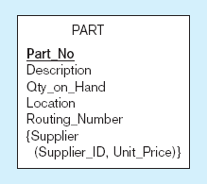
Example of Specialization
a) Entity type PART
Only applies to manufactured parts
Applies only to purchased parts

Slide 14
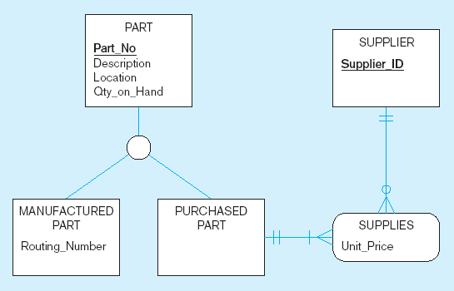
Example of Specialization (2)
b) Specialization to MANUFACTURED PART and
PURCHASED PART
Note: multivalued attribute was replaced by an associative entity relationship to another entity

Slide 15
Generalization
Generalization
  Identifies more generic entity supertype from lower-level entity subtypes
  Bottom-up process
  Based on grouping common characteristics and relationships of the subtypes

Slide 16
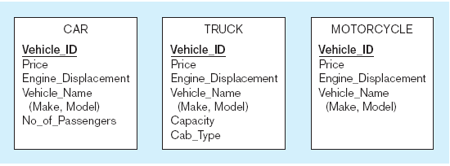
Example of Generalization
a) Three entity types: CAR, TRUCK, and MOTORCYCLE
All these types of vehicles have common attributes

Slide 17
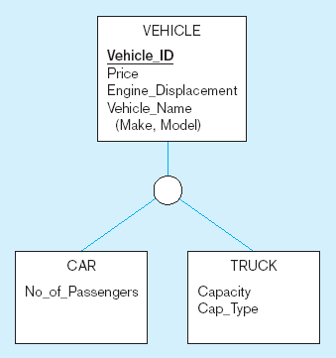
Example of generalization (2)
b) Generalization to VEHICLE Supertype
So we put the shared attributes in a Supertype
Note: no sub for motorcycle, since it has no unique attributes

Slide 18
Constraints on Specialization/Generalization
2 constraints may apply to specialization/generalization:
  Participation constraint
  Disjoint constraint

Slide 19
Participation Constraint
Specifies whether entity Supertype occurrence must be a member of at least one Subtype
Mandatory/Total participation constraint
  Every Supertype occurrence must be member of at least one Subtype
  Written as (Mandatory, <Disjoint Constraint>)
Optional/Partial participation constraint
  Some Supertype occurrences that are not members of any Subtype
  Written as (Optional, <Disjoint Constraint>)

Slide 20
Participation Constraint – Mandatory(also known as Total)
Student
(Mandatory, Or)
PostGrad
UnderGrad
Student MUST be a postgraduate or undergraduate

Slide 21
Participation Constraint – Optional (also known as Partial)
Staff
Work
Department
staffNo (PK)
name
birthDate
1..*
1..1
1..1
(Optional, And)
Lead_By
Typist
Lecturer
Dean
typeSpeed
field
startDate
1..1
Staff can be as a TYPIST, LECTURER, DEAN or a Staff

Slide 22
Disjoint Constraint
Disjoint constraint
  Also known as non-overlapping Subtype
  Subtype that contain unique subset of Supertype entity set
  An instance of the Supertype cannot represent more than one subtype entities
Nondisjoint constraint
  Also known as overlapping Subtype
  Subtype that contain non-unique subsets of Supertype entity set
  Allow an instance of the Supertype to represent more than one subclas entities

Slide 23
Disjoint (Mandatory, Or)
Student
(Mandatory, Or)
PostGrad
UnderGrad
Student MUST be a postgraduate
Student MUST be a undergraduate
OR
Student CANNOT be both - postgraduate and undergraduate in one time

Slide 24
Nondisjoint (Optional, And)
Staff
Work
Department
staffNo (PK)
name
birthDate
1..*
1..1
1..1
(Optional, And)
Lead_By
Typist
Lecturer
Dean
typeSpeed
field
startDate
1..1
Staff can be as a TYPIST, LECTURER, DEAN or a Staff
Within the same time, Lecturer can be a Dean

Slide 25
Constraints on Specialization/Generalization
Four categories of constraints of specialization and generalization:
  mandatory and disjoint (Mandatory Or)
  optional and disjoint (Optional, Or)
  mandatory and nondisjoint (Mandatory, And)
  optional and nondisjoint (Optional, And)

Slide 26
More Examples
Person MUST be an Employee or Student , but can be both at the same time
Person
(Mandatory, And)
Employee
Student
(Optional, And)
(Mandatory, Or)
Typist
Lecturer
Dean
PostGrad
UnderGrad
Employee can be a Typist , Lecturer, Dean or Employee but can be both at the same time
Student MUST be a PostGrad or UnderGrad , but CAN’T be both at the same time

Slide 27
Nondisjoint (Optional, Or)
Employee
Has
Dependent
staffNo (PK)
name
birthDate
1..*
0..1
EMP_Num (PK)
staffNo (PK)
DEP_Name
DEP_Relation
(Optional, Or)
Pilot
Mechanic
Accountant
PIL_License
PIL_Rating
PIL_Medi_Type
MEC_Title
MEC_Cert
ACC_Title
ACC_Type
Employee can only be as a Pilot, Mechanic, Accountant or a Staff

Slide 28
CHAPTER 4:
Example of EERD
DCI2033 – DATABASE SYSTEMS

Slide 29
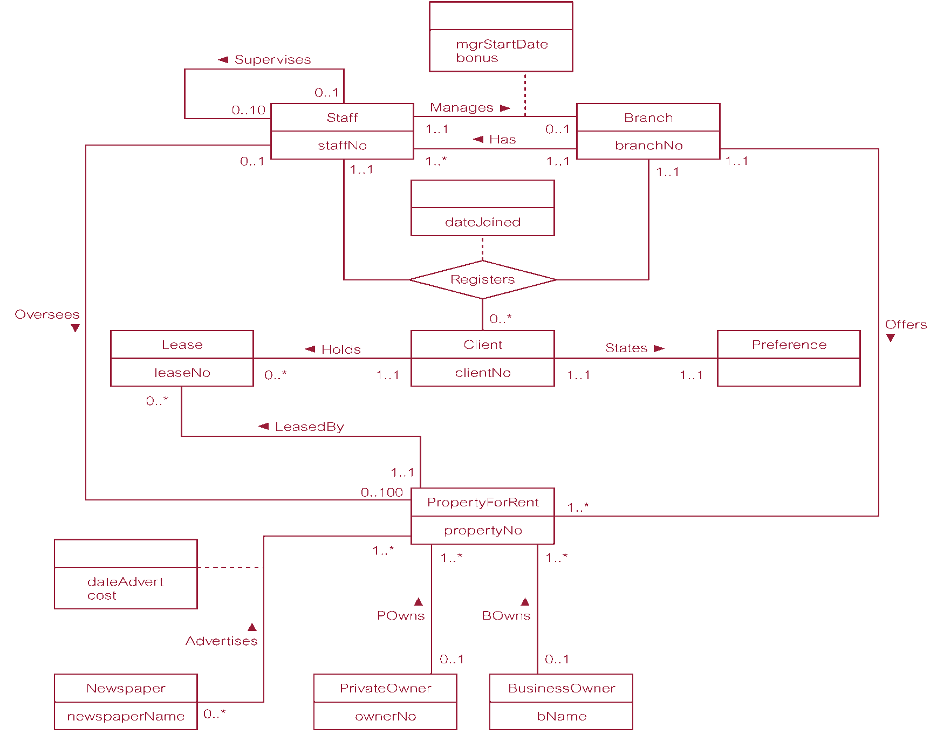
Example on ER to EER

Slide 30
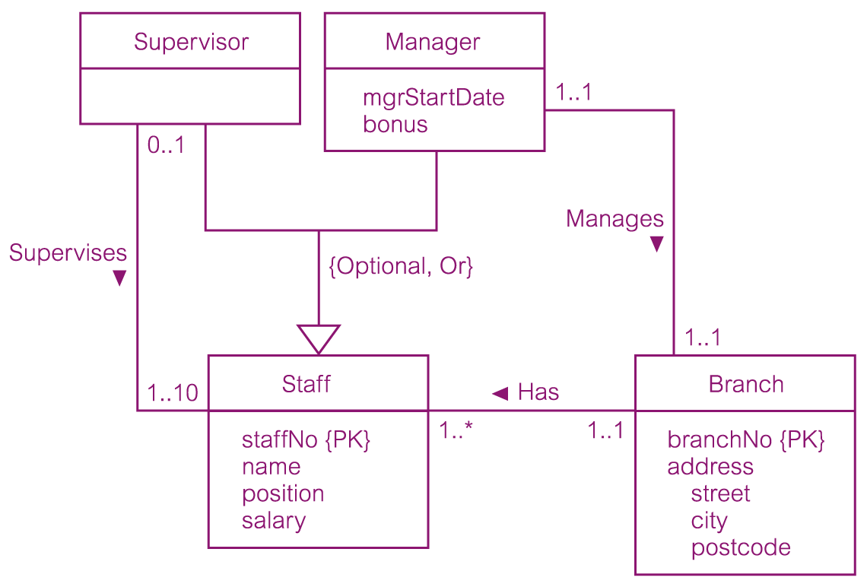
DreamHome worked example - Staff Supertype with Supervisor and Manager Subtypes
© Pearson Education Limited 1995, 2005

Slide 31
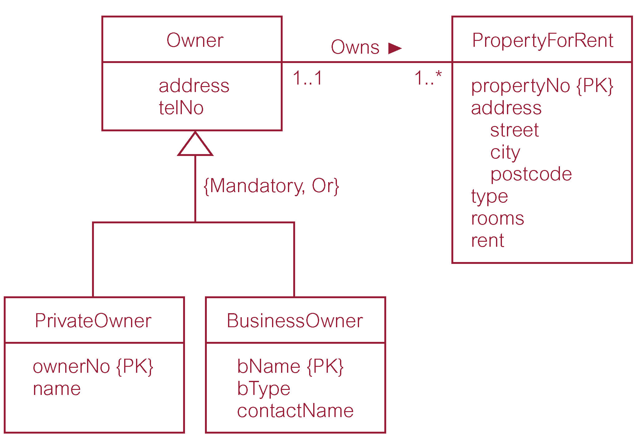
DreamHome worked example - Owner Supertype with PrivateOwner and BusinessOwner Subtypees
© Pearson Education Limited 1995, 2005

Slide 32
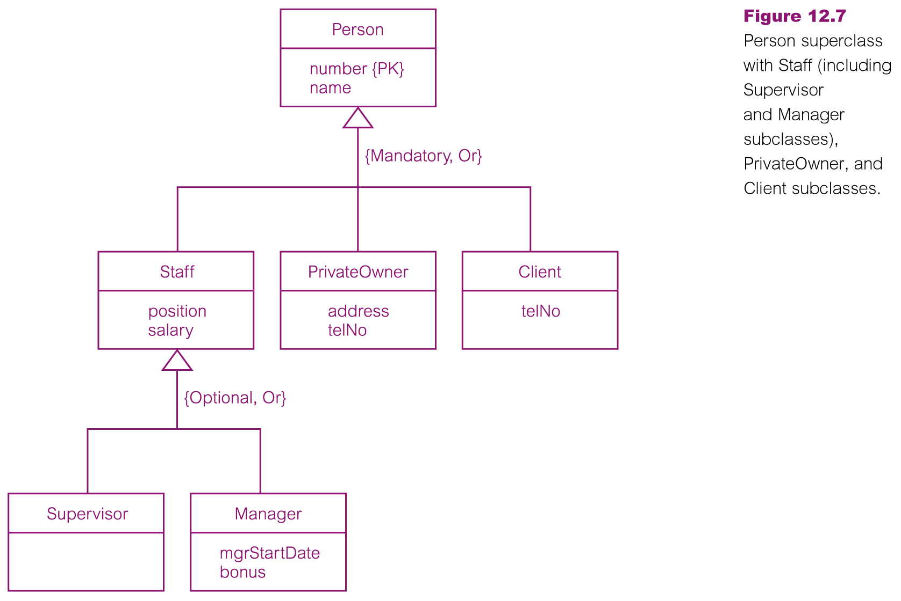
DreamHome worked example - Person Supertype with Staff, PrivateOwner, and Client Subtypees

Slide 33
CHAPTER 4:
Other type of Relationships
DCI2023 – DATABASE SYSTEMS

Slide 34
Aggregation and Composition
Other types of relationships
Aggregation
Composition
Aggregation
  is a relationship between two entities A and B; that represent the condition of A as part of B
A
B
B is whole entity
‘A is a part of B’

Slide 35
Aggregation and Composition
Department
Has
Lecturer
Department is whole entity
Supervise
Offer
Project
‘the lecturers and projects are a part of the department ’

Slide 36
Aggregation and Composition
Composition
  is a relationship between two entities A and B that represent A as part of B and B controls the lifetime of A.
A
B
B is composite entity
‘A is the composition of B.
B controls the lifetime of A ’

Slide 37
Aggregation and Composition
Composition
Department
Course
offer
1..*
1..1
Department is composite entity
‘Course is a composition of Department
and the Department controls the lifetime of the Course’

Slide 38
CHAPTER 4:
Design Cases
BCI2023 – DATABASE SYSTEMS

Slide 39
Design Cases:
Learning Flexible Database Design
Data modeling and design requires skills acquired through experience
Experience acquired through practice
Four special design cases that highlight:
  Importance of flexible design
  Proper identification of primary keys
  Placement of foreign keys

Slide 40
Design Case #1: Maintaining History of Time-Variant Data
Normally, existing attribute values replaced with new value without regard to previous value
Time-variant data:
  Values change over time
  Must keep a history of data changes
Keeping history of time-variant data equivalent to having a multivalued attribute in your entity
Must create new entity in 1:M relationships with original entity
New entity contains new value, date of change

Slide 41
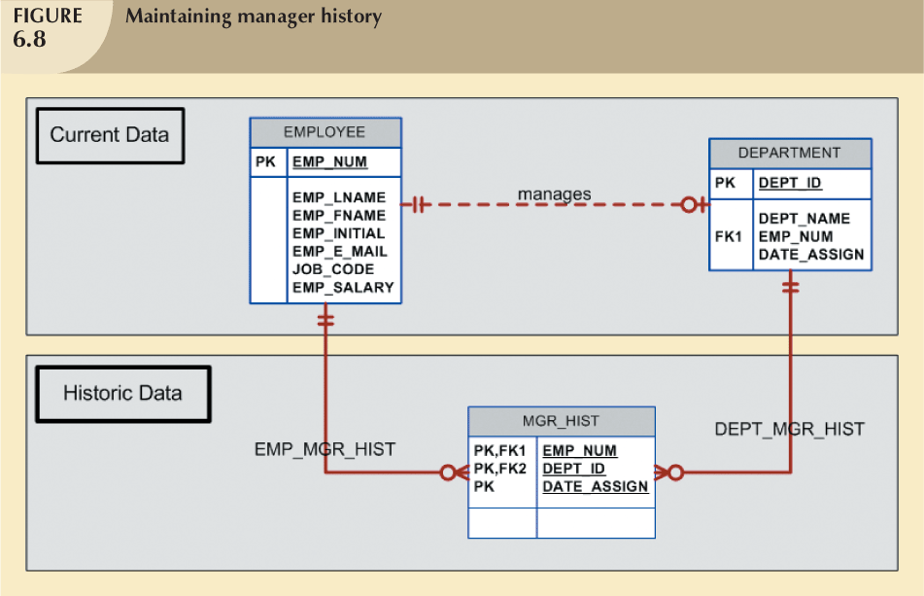

Slide 42
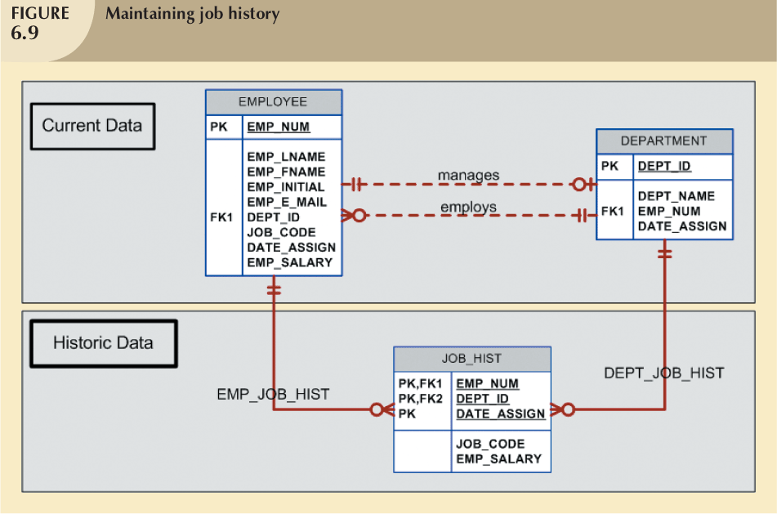

Slide 43
Design Case #2: Fan Traps
Design trap occurs when relationship is improperly or incompletely identified
  Represented in a way not consistent with the real world
Most common design trap is known as fan trap
Fan trap occurs when one entity is in two 1:M relationships to other entities
  Produces an association among other entities not expressed in the model

Slide 44

An Example of a Fan Trap
division operates one or more branches and has one or more staff
© Pearson Education Limited 1995, 2005

Slide 45
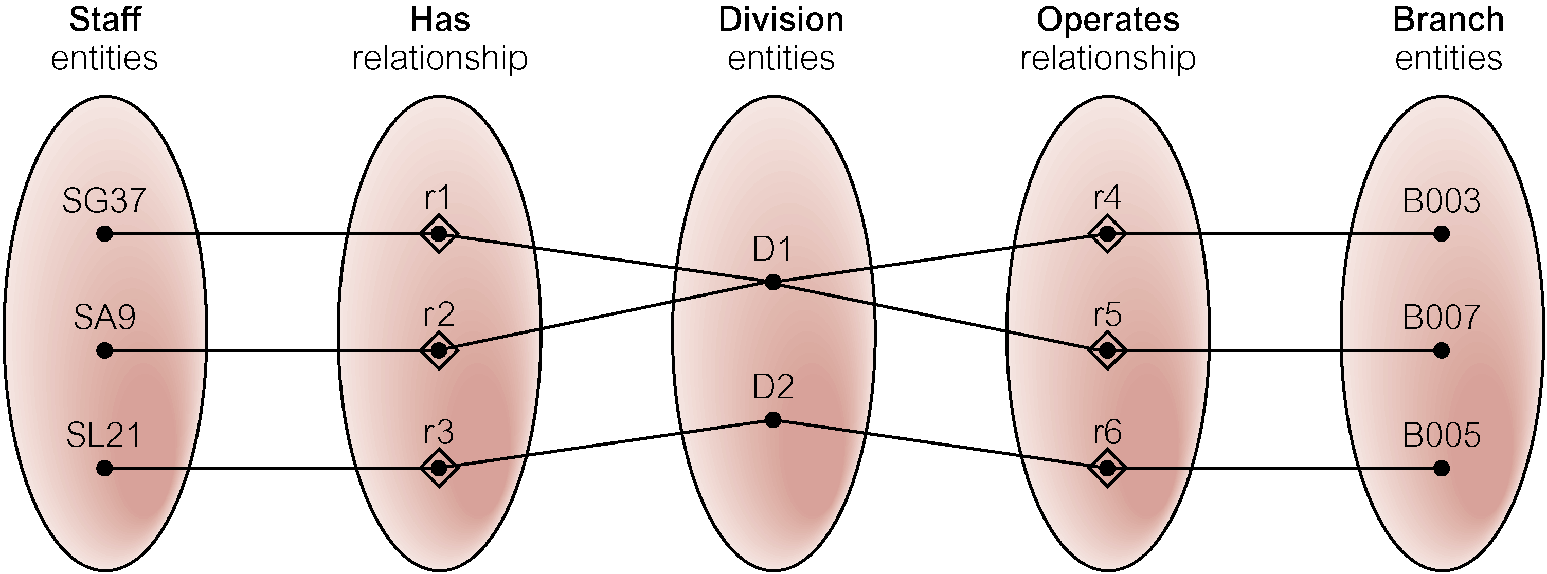
Semantic Net of ER Model with Fan Trap
At which branch office does staff number SG37 work?
© Pearson Education Limited 1995, 2005

Slide 46
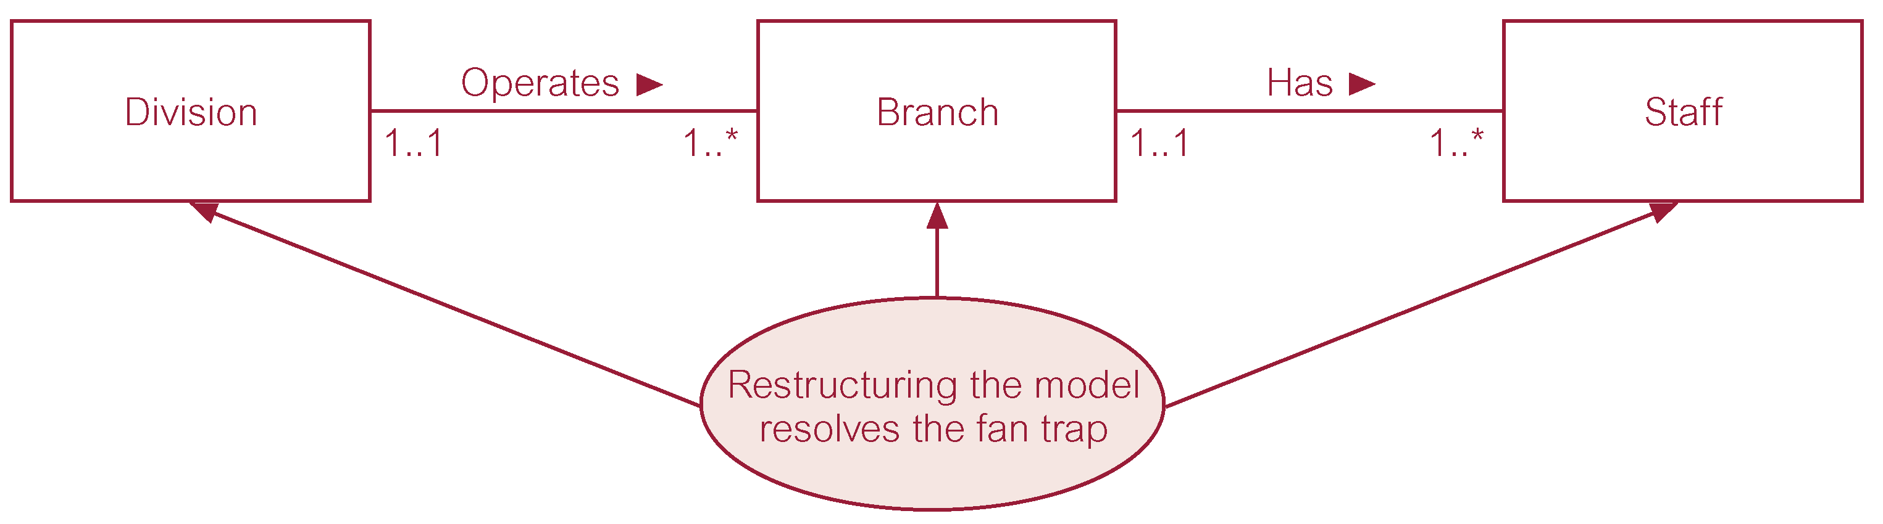
Restructuring ER model to remove Fan Trap
© Pearson Education Limited 1995, 2005

Slide 47
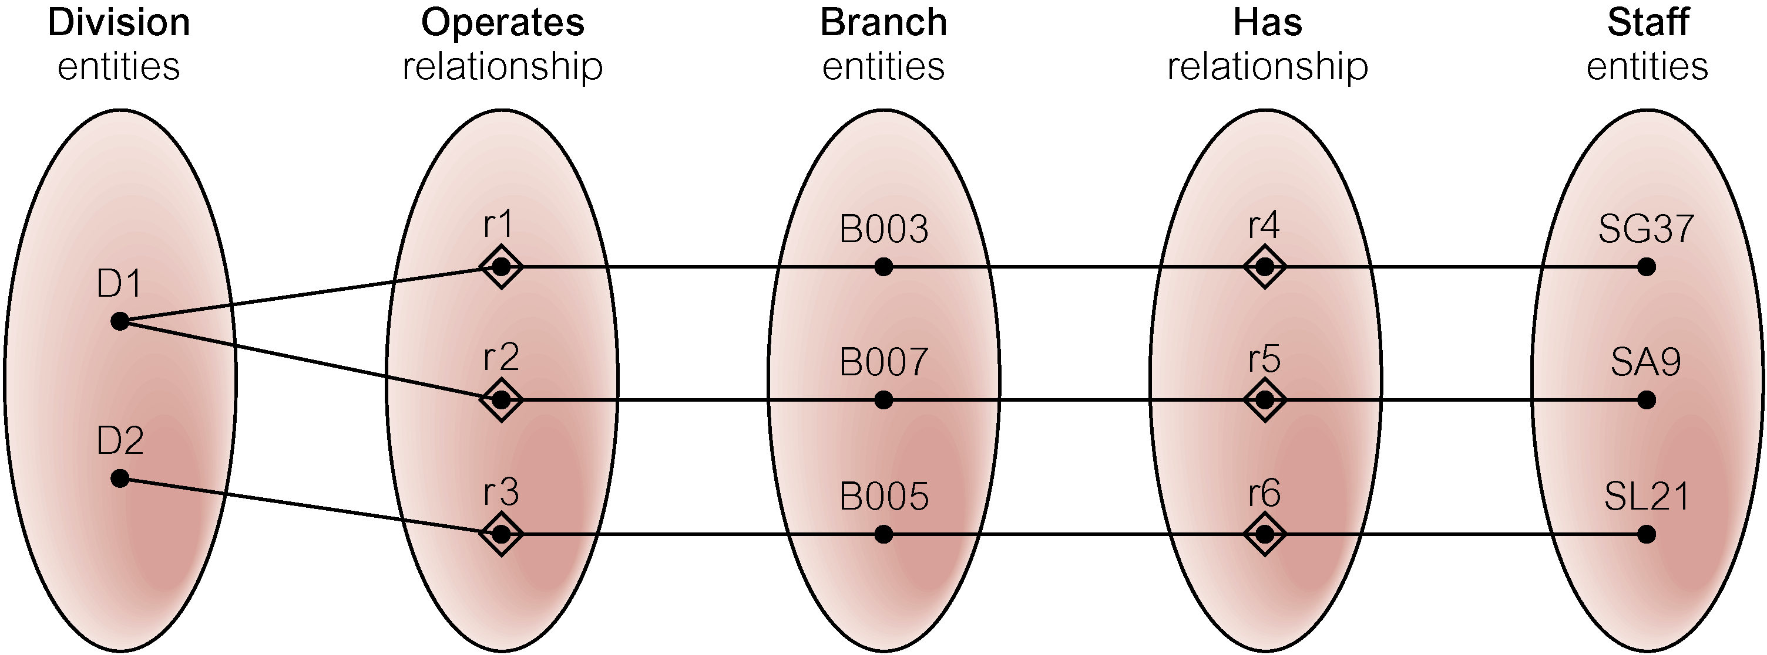
Semantic Net of Restructured ER Model with Fan Trap Removed
SG37 works at branch B003.
© Pearson Education Limited 1995, 2005

Slide 48
Design Case #3:
Redundant Relationships/Chasm Trap
Redundancy is seldom a good thing in database environment
Occur when there are multiple relationship paths between related entities
Main concern is that redundant relationships remain consistent across model
Some designs use redundant relationships to simplify the design

Slide 49

An Example of a Chasm Trap
single branch has one or more staff who oversee zero or more property for rent
Not all staff oversee the property and not all properties overseen by a member of staff
??? → which properties are available at each branch?
© Pearson Education Limited 1995, 2005

Slide 50
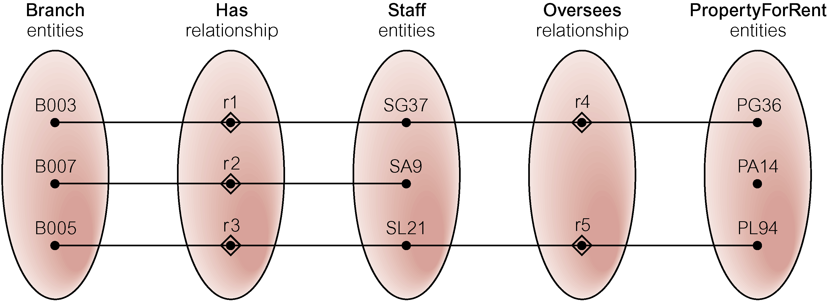
Semantic Net of ER Model with Chasm Trap
At which branch office is property PA14 available?
© Pearson Education Limited 1995, 2005

Slide 51
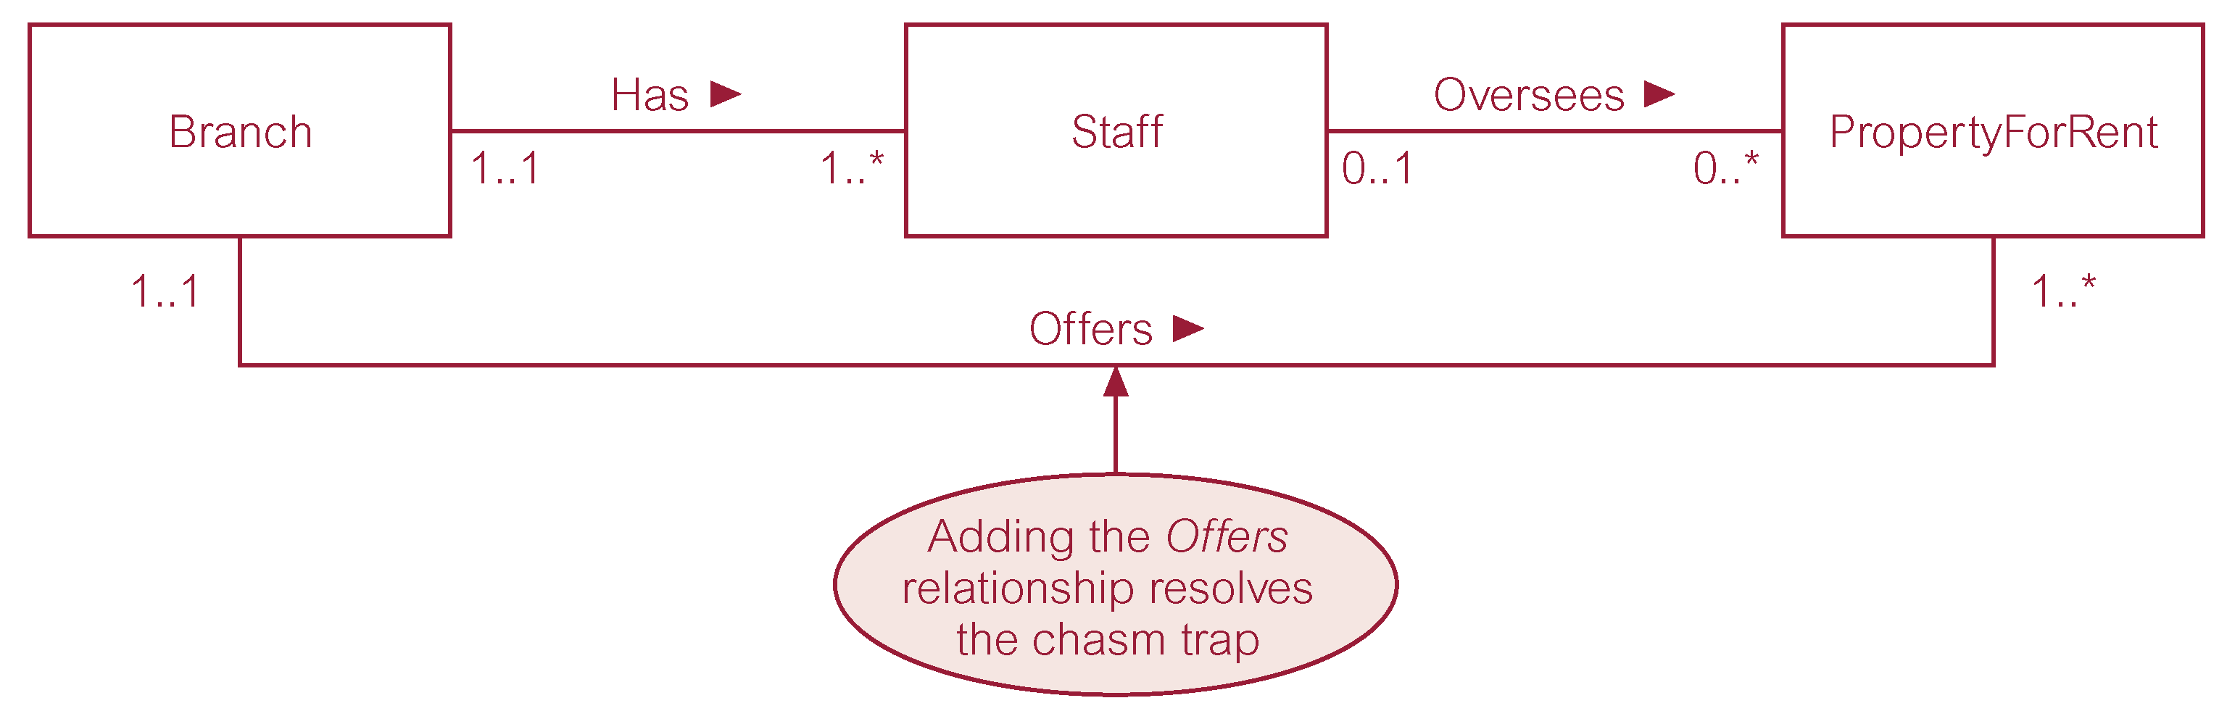
ER Model restructured to remove Chasm Trap
© Pearson Education Limited 1995, 2005

Slide 52
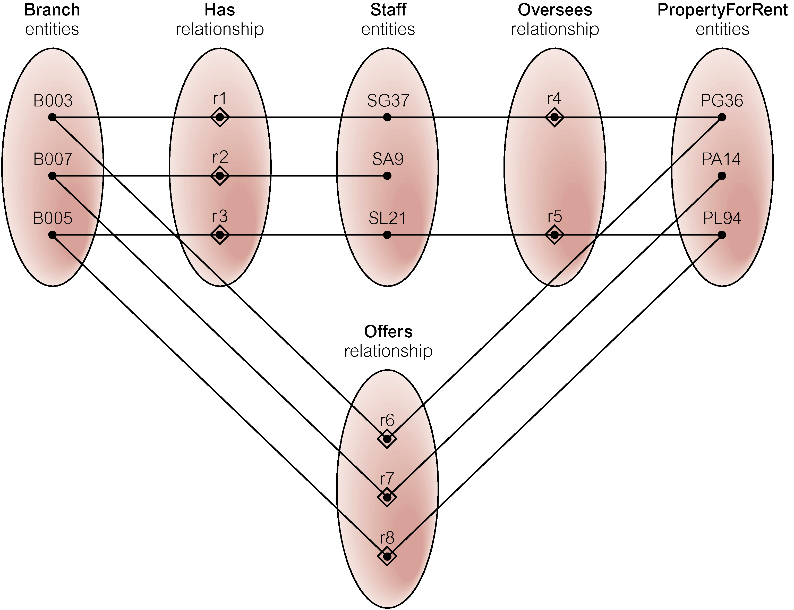
Semantic Net of Restructured ER Model with Chasm Trap Removed
© Pearson Education Limited 1995, 2005

Slide 53
Data Modeling Checklist
Data modeling translates specific real-world environment into data model
  Represents real-world data, users, processes, interactions
EERM enables the designer to add more semantic content to the model
Data modeling checklist helps ensure data modeling tasks successfully performed
Based on concepts and tools learned since Chapter 3

Slide 54
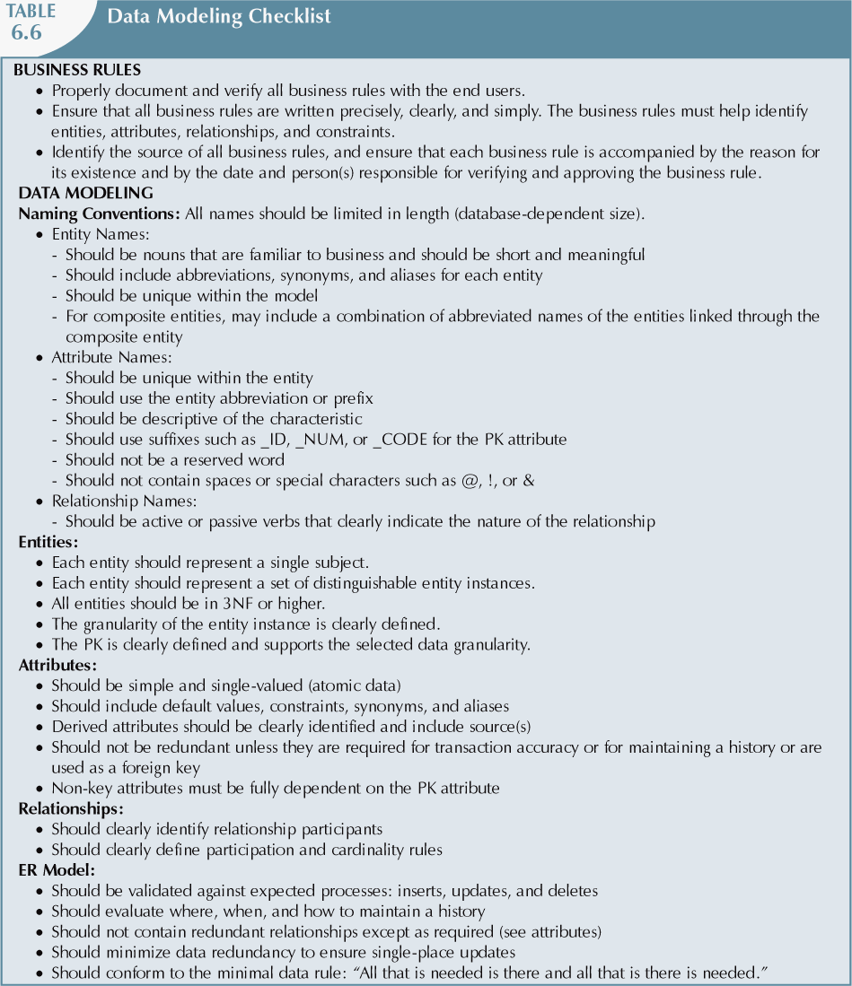

Slide 55
Highlights
Extended entity relationship (EER) model adds semantics to ER model
  Adds semantics via entity Supertype, subtclass, and clusters
  Entity Supertype is a generic entity type related to one or more entity Subtype
Specialization hierarchy
  Depicts arrangement and relationships between entity Supertype and entity Subtype
Inheritance means an entity Subtype inherits attributes and relationships of Supertype

Slide 56
Highlights (2)
Four categories of constraints of specialization and generalization:
  mandatory and disjoint (Mandatory Or)
  optional and disjoint (Optional, Or)
  mandatory and nondisjoint (Mandatory, And)
  optional and nondisjoint (Optional, And)

Slide 57
Highlights (3)
Time-variant data
  Data whose values change over time
  Requires keeping a history of changes
To maintain history of time-variant data:
  Create entity containing the new value, date of change, other time-relevant data
  Entity maintains 1:M relationship with entity for which history maintained

Slide 58
Highlights (4)
Fan trap:
  One entity in two 1:M relationships to other entities
  Association among the other entities not expressed in model
Redundant relationships occur when multiple relationship paths between related entities
  Main concern is that they remain consistent across the model
Data modeling checklist provides way to check that the ERD meets minimum requirements

